Slide 1
Tangent bug Project
By: Joe Brock, Robert Pierce, Josh Lilly, sara saad, and zifu wong

Slide 2
Problem statement
Say we have a robot, and we need to get from point A to B
Problems that arise:
How do we move it without bumping into obstacles?
How are we going to implement object dodging?
What are the edge cases for going around obstacles?
In other words, how are we going to account for movement in a dynamic environment?

Slide 3
Solution for said problem
If we ran into an object determine four things:
Can we sense it?
Is there a point on obstacle whose magnitude is closest to goal?
If so, is it possible to move there?
If so, are we going to wall-follow or head straight to goal?
We decided to do this because it can be a useful tool for both simulation and path planning.

Slide 4
Motivation for Problem
The reason why we choose this solution is as follows:
1) We wanted a means in which we path plan via wall-following objects
2) We wanted to dynamically shape the environment of the robot as we moved

Slide 5
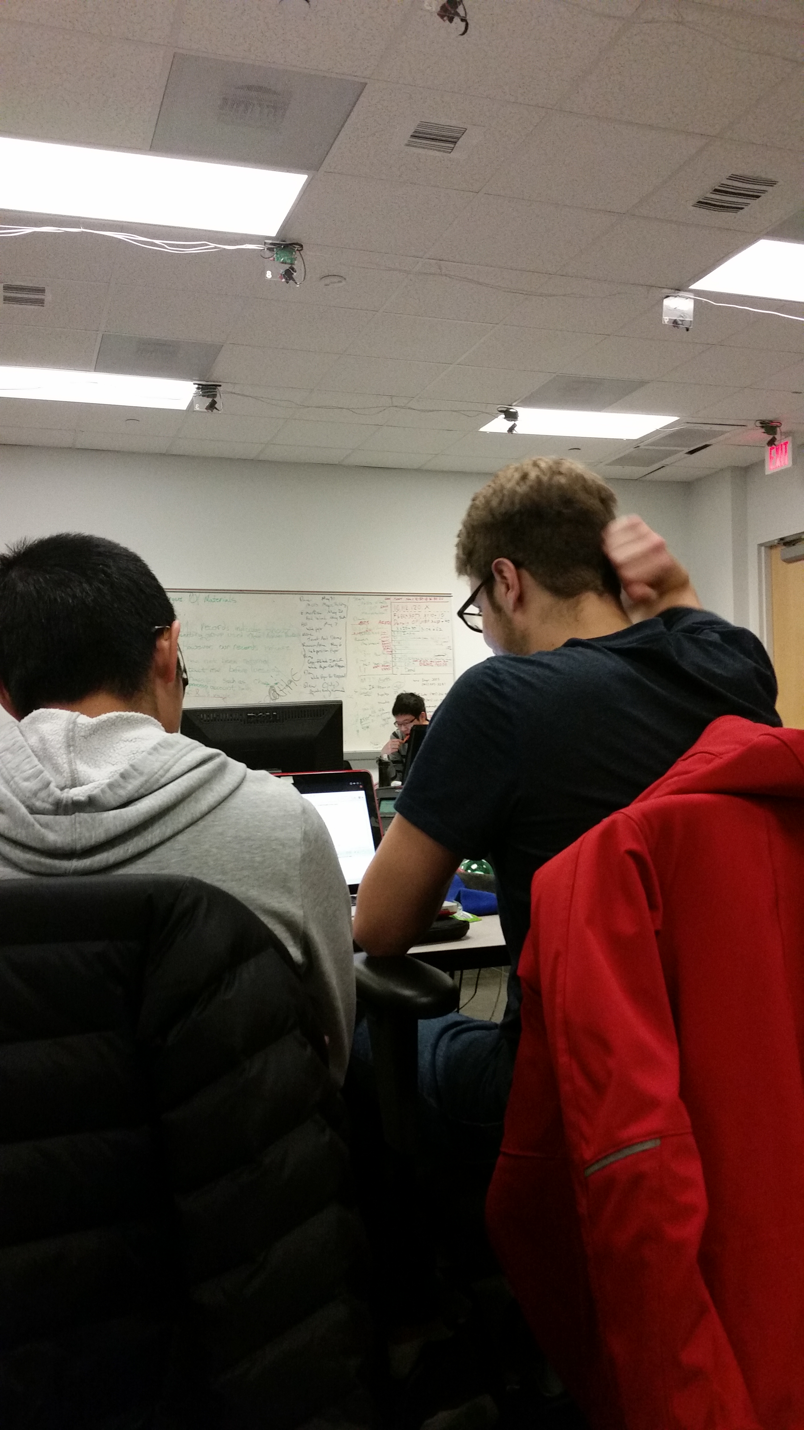
Further analysis into our methodology

Slide 6

Challenges for the project
Lack of time and bad scheduling
Problems with robot and robot path
Value dropping

Slide 7
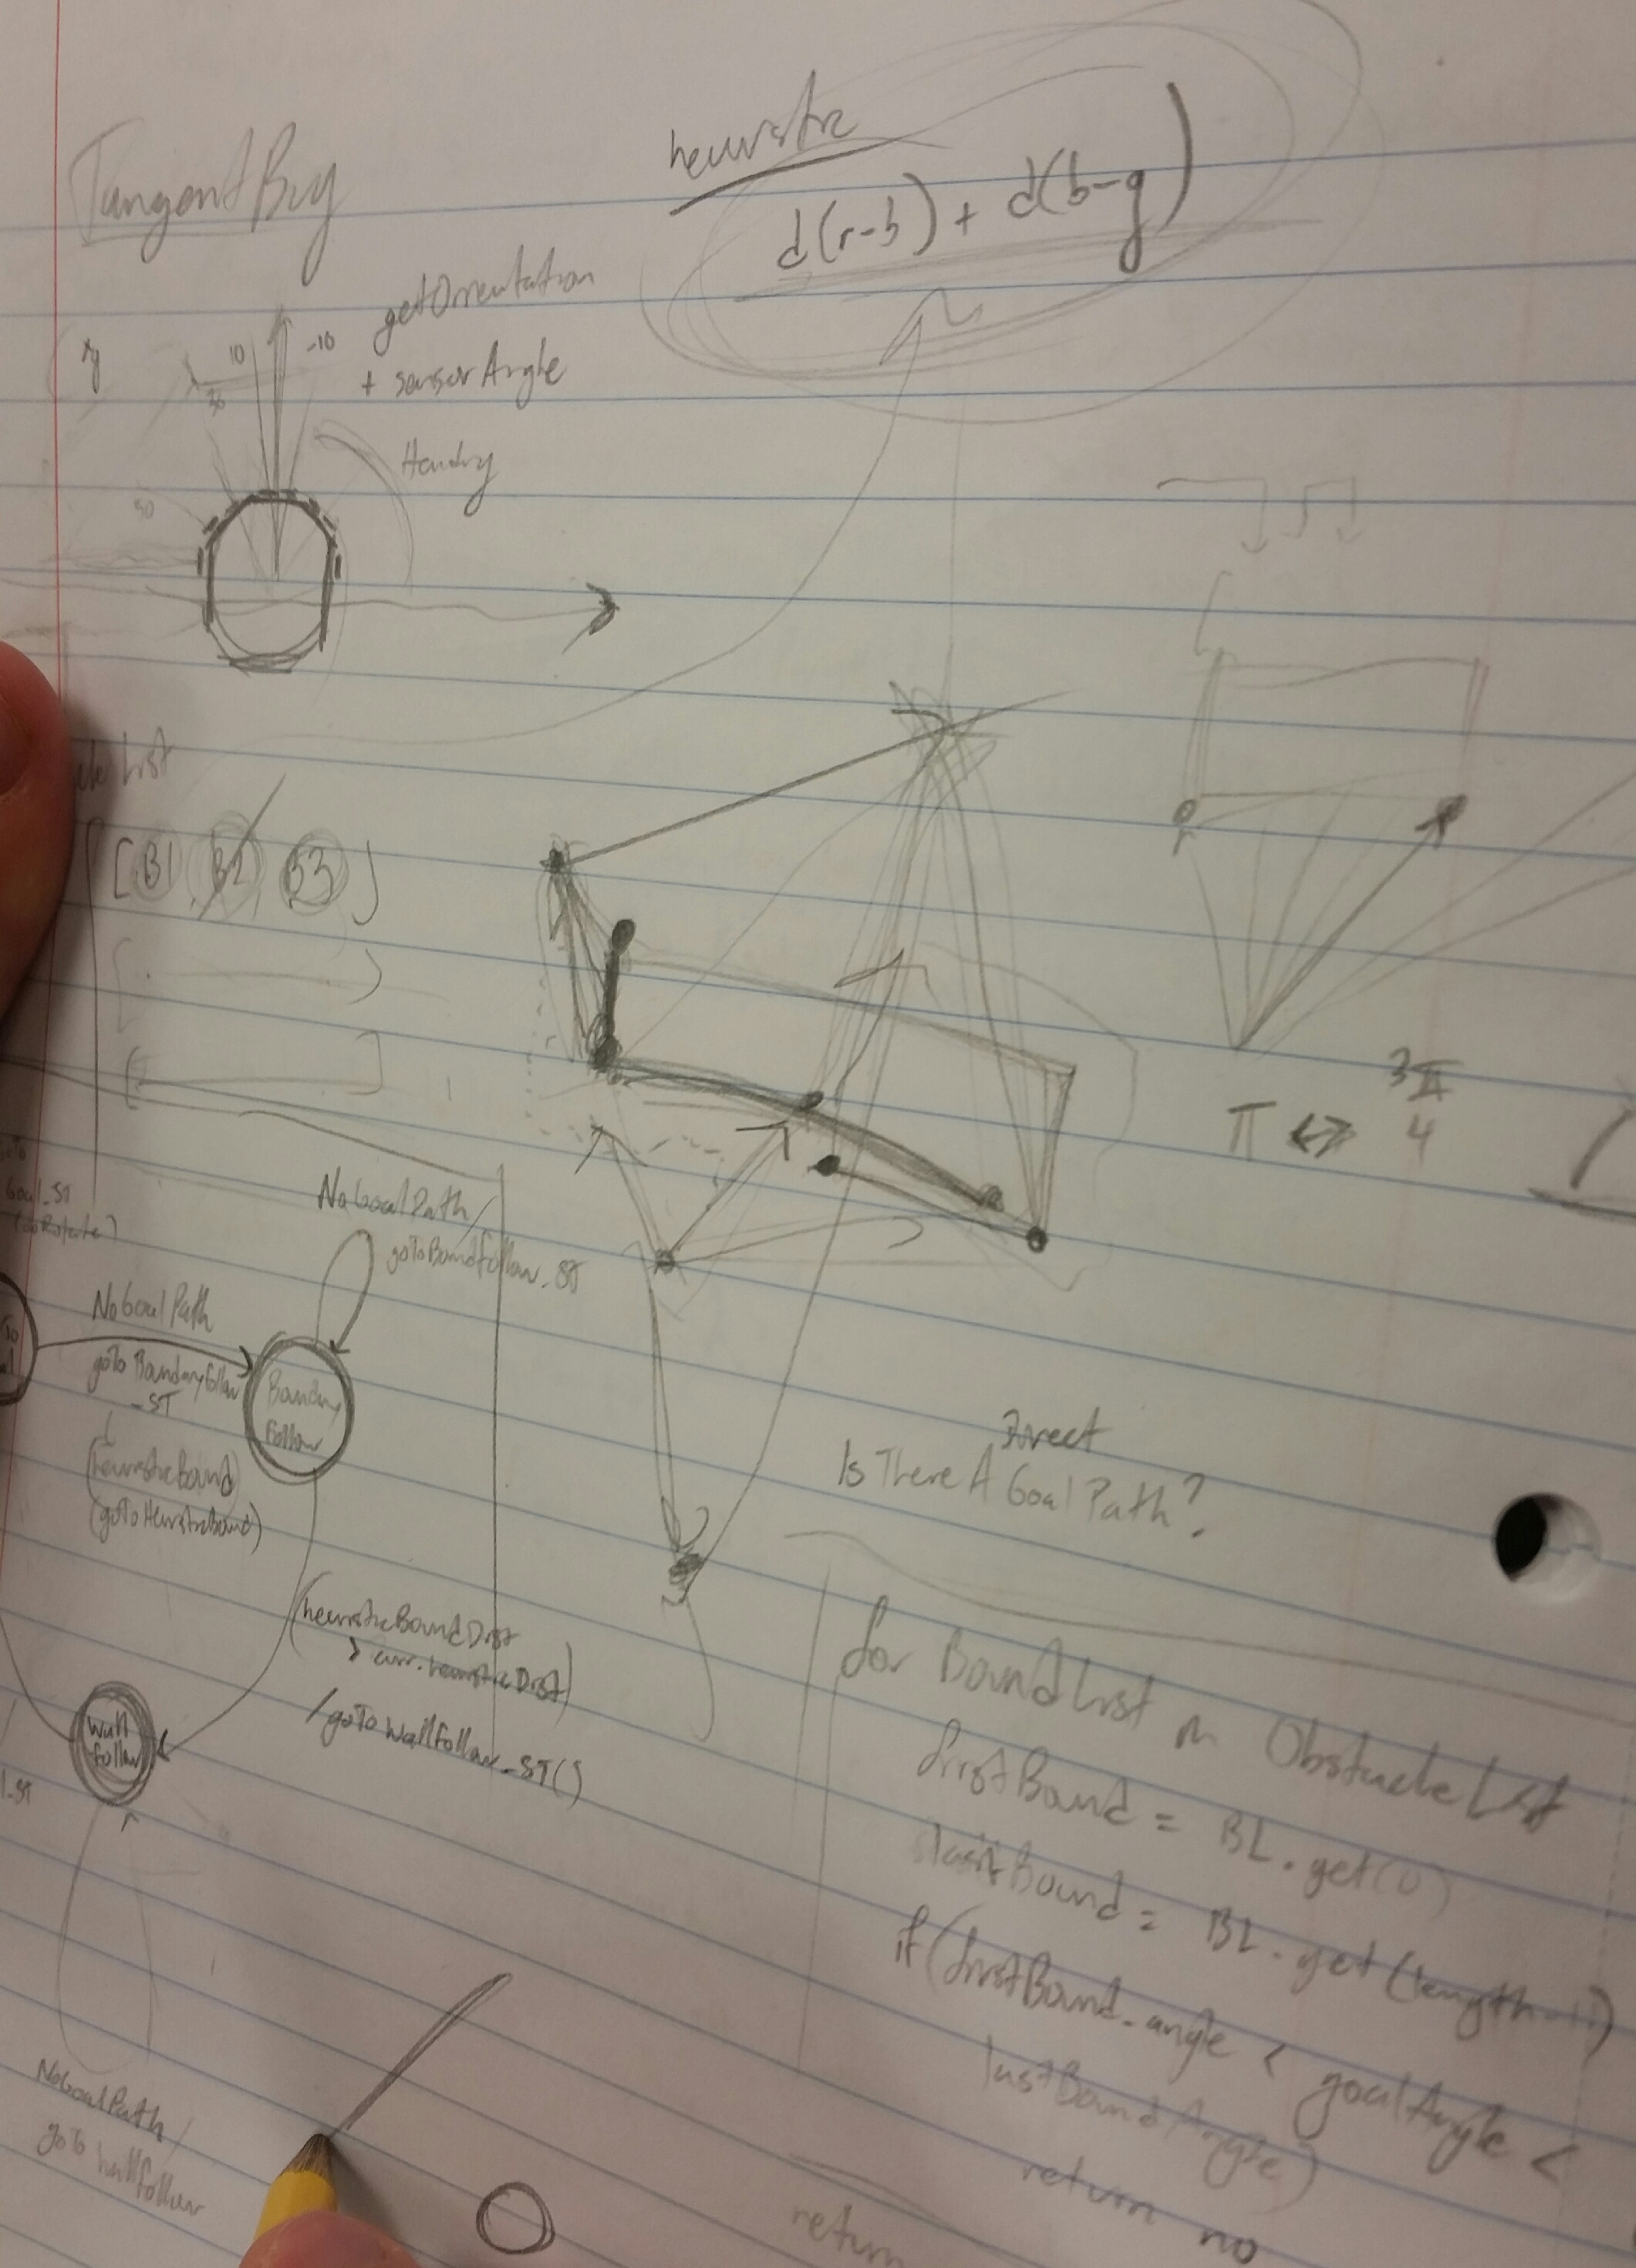
Methodology and implementation
Math was pretty straight-forward.
Coding was only really difficult because of edge cases as well as poor sensor readings.

Slide 8
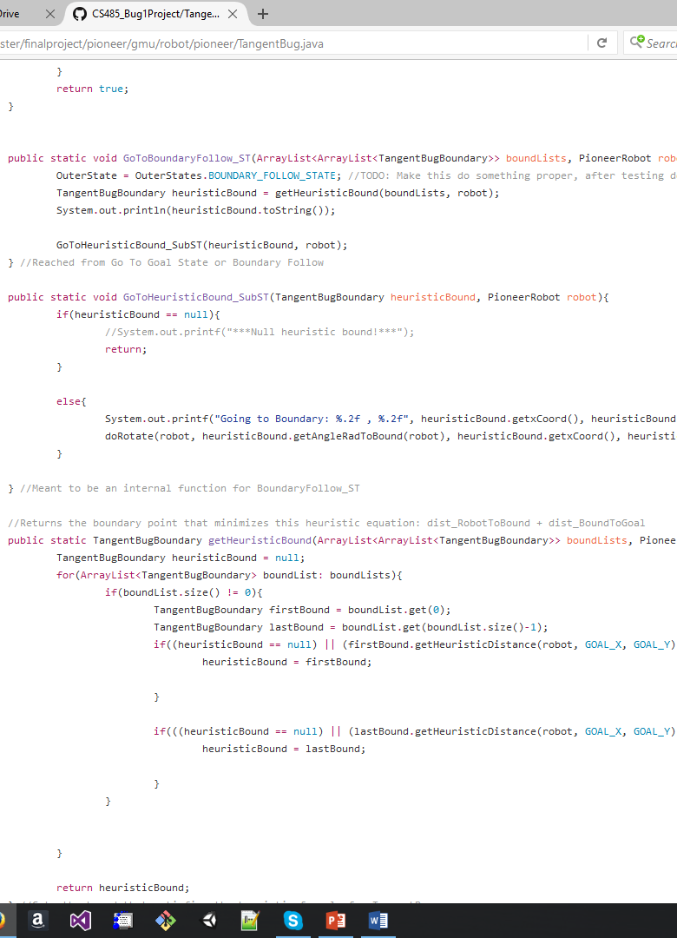
More In terms of implementation
Here is an older version of our Heuristic code

Slide 9
Our robot
Our Robot Attempting to Traversing Through With One Obstacle:
https://youtu.be/d7FXKxhL1E0
Our Robot Horribly Failing at traversing through more than One Obstacle:
https://youtu.be/m-ts1PzUhvA
https://youtu.be/KoZPanz4-b4
https://youtu.be/Lf6rJ8DQe1w

Slide 10
Things we felt were great vs. what would’ve been better
What was great
What would’ve been better
Planning
Sensing
Movement
Buffer zones

Slide 11
Any QuestionS?

